Slide 1


Drug-Facilitated Sexual Assault
Amy Nguyen
Professor Wick
PHRX 4001W
April 11, 2024

Slide 2
TRIGGER WARNING
Sexual Assault

Slide 3
Every 68 seconds, an American is sexually assaulted.
Only 25 rapists out of every 1,000 will end up in prison.

Slide 4
What is Drug-Facilitated Sexual Assault?
“When I was raped I was 6’4” and 220 lbs. I truly believed that I could go anywhere I wanted and no one would bother me.”
- Johnathon, a survivor of drug-facilitated sexual assault and RAINN Speakers Bureau member.
Drug-facilitated sexual assault (DFSA) - alcohol or drugs are used to compromise an individual’s ability to consent.
“Date Rape Drugs”
Can happen to anyone, by anyone
Notes:
Substances make it easier for the perpetrator to commit sexual assault. It reduces any resistance and prevents the victim from remembering details of the assault.
These drug used are also known as date rape drugs, which is mis-leading because they usually do not involve a dating situation, although they could.
This can happen to anyone, whether it’s a date, a stranger, an acquaintance, or someone you have known for a long time and feel comfortable with.
This is a quote from Jonathan, a survivor of drug-facilitated sexual assault, that is willing to share his story.

Slide 5
Drugs Used in Sexual Assault
Flunitrazepam (Rohypnol)
Benzodiazepine - CIV
Not approved in the US – used in other countries to treat insomnia
Gamma-Butyrolactone (GBL)
List I chemical
Precursor chemical for illegal production of GHB
Gamma-Hydroxybutyric Acid (GHB)
FDA-approved GHB product:
Sodium oxybate, Xyrem®
Approved for treatment of narcolepsy
Ketamine
Schedule III
Notes:
How these drugs work:
These drugs are typically odorless, colorless, and tasteless when placed in a drink. Within 30 minutes, the individual will feel the effects and struggle to move or even pass out.
Because of the effects of the drug, the victim may have little recollection of what happened, which is why many victims do not report the crime.

Slide 6
Psychological Ramifications

Slide 7

Emotional Trauma
Impaired Trauma Memory
Guilt and Self-Blame
Extreme powerlessness
Re-experiencing symptoms
Notes:
Many DFSA victims are unable to fully remember the details of the assault due to the drugs used, leaving them confused, uncertain, powerless. The missing gaps can haunt them as they struggle to put together what really happened.
DFSA victims, whether the drug ingestion was voluntary or involuntary, often experience intense feelings of guilt and self-blame. This is exacerbated by the perception that they willingly consumed drugs or alcohol, even if they were unknowingly drugged.
The deprivation of cognition and control during a DFSA assault subjects the victim to an extreme form of powerlessness. This "mind rape" can be a distinct and deeply traumatic aspect of the experience.
Despite the memory gaps, DFSA victims still commonly experience distressing reexperiencing symptoms like flashbacks and nightmares. This can be particularly disturbing without the ability to cognitively connect the trauma.

Slide 8


Perpetrator Motivations
Predatory mindset
Sexual Entitlement
Opportunism
Notes:
DFSA perpetrators are motivated by a desire to exert power and control over the victim, taking advantage of their diminished capacity.
Some perpetrators may hold beliefs that they are entitled to sex and use drugs/alcohol as a means to overcome a victim's resistance and consent.
In some cases, perpetrators may simply take advantage of situations where individuals are already intoxicated, without necessarily planning the assault in advance. The impaired state of the victim presents an opportunity.

Slide 9
Legal Ramifications

Slide 10
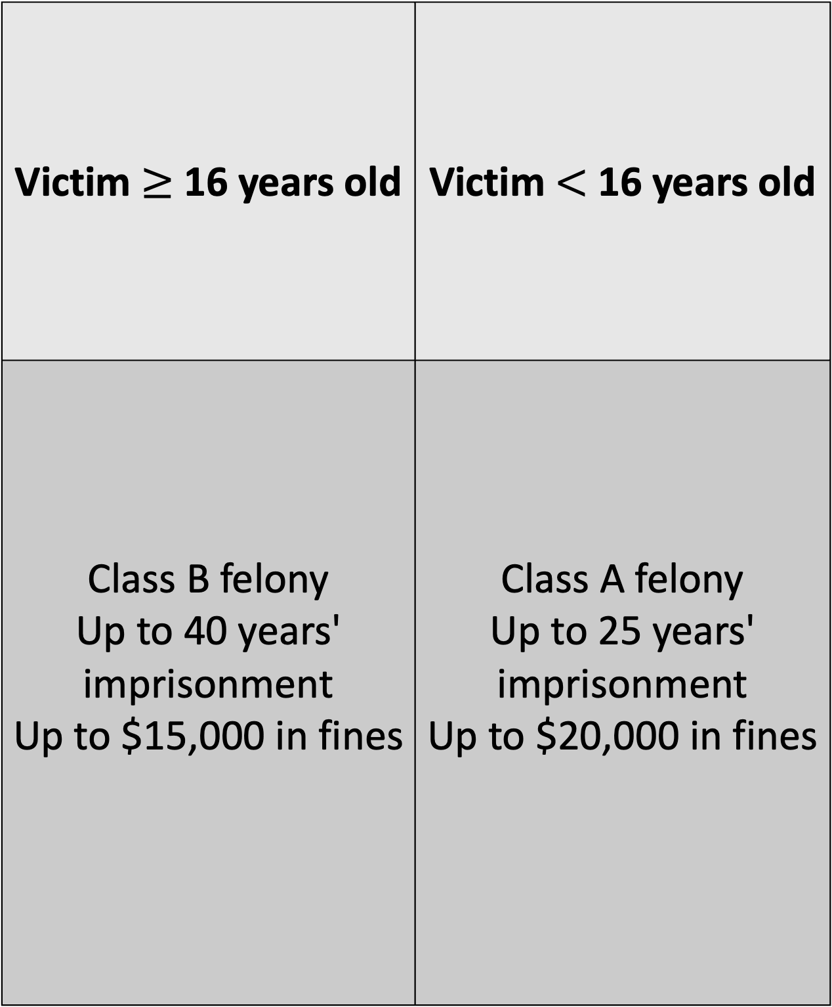
Victim $≥$ 16 years old | Victim $<$16 years old
Class B felony Up to 40 years' imprisonment Up to $15,000 in fines | Class A felony Up to 25 years' imprisonment Up to $20,000 in fines
Current Legal Framework
Definitions vary state to state
In Connecticut
DFSA is considered a form of rape and is therefore charged as sexual assault in the first degree.

Slide 11

Challenges in Prosecution
Amnesia
Lack of physical evidence
Narrow window for detecting date rape drugs in the victim's system
Bias against victims who were intoxicated
Notes:
Many DFSA victims experience amnesia because of the drugs, making it difficult for them to recall and describe the details of the assault. This lack of memory can undermine the strength of their testimony.
Without physical signs of struggle, such as fingernail scrapings or bite marks, there may be limited forensic evidence to corroborate the victim's account.
The window for detecting date rape drugs in the victim's system is often very narrow, as the drugs metabolize quickly. Hair testing can extend the detection window, but is not always done. This makes it challenging to obtain conclusive toxicological evidence.
If the victim was voluntarily consuming alcohol or drugs prior to the assault, law enforcement and juries may be less likely to believe their account or consider them a "reliable" witness. There is often a bias against victims who were intoxicated.

Slide 12
Societal Ramifications

Slide 13

Stigmatization
Credibility
Social Isolation
Victim Blame
"Why didn't you fight it?"
“Why didn't you leave the situation?"
“What were you wearing?”
Notes:
DFSA victims are often perceived as less credible, especially if they were voluntarily using drugs or alcohol prior to the assault. There is a bias against intoxicated victims.
Victims may be blamed for their own victimization, with questions like "Why didn't you fight it?" or "Why didn't you leave the situation?" This reflects a "just world" mentality that the victim must have done something to deserve the assault.
Women are often more harshly judged for their sexual behavior compared to men. The sexual violence perpetrated against DFSA victims is seen as a "just” because of the way they were dressed.
The severe stigmatization experienced by some DFSA victims can lead to a form of "social death", where they are ostracized from their communities and social relationships.
This social isolation and rejection can be as traumatic as the assault itself, hindering the victim's ability to heal and rebuild their life.

Slide 14
Addressing Drug-Facilitated Sexual Assault
CT100 Kit
Standardized sexual assault kit used in all CT hospitals.
Retrieving samples including debris, blood, hair, urine, and genital swabs.
Collected within 120 hours (5 days)
Train Healthcare Providers
Conduct sexual assault forensic exams and toxicology testing to detect date rape drugs
CT400 Kit
Urine and blood testing to detect the presence of date rape drugs or other substances.
Urine: Collected within 120 hours (5 days)
Blood: Collected within 48 hours (2 days)
Connecticut Alliance to End Sexual Violence
9 sexual assault crisis programs
24-hour toll free confidential hotline
Via phone, text, or chat, or at their local center
Sexual Assault Victim Advocates
Notes:
Ensure healthcare providers are trained to conduct sexual assault forensic exams and toxicology testing to detect date rape drugs
Advocates are not there to help with evidence collection or health care, but to support the patient, and to ensure the patient is informed about their options.

Slide 15
THANK YOU!
Questions?

